Slide 1
June 22nd Meeting
Ainsley Lai

Slide 2
Agenda
Spectrograms
OOI change in data storage → cannot query data (still)
SPDF of near identical position/speed points
Restrict to AB, EC, and CC hydrophones, 2 MMSIs
Low data
EC missing pickle files, hydrophone not accessible → cannot generate needed psd values
AIS mapping

Slide 3
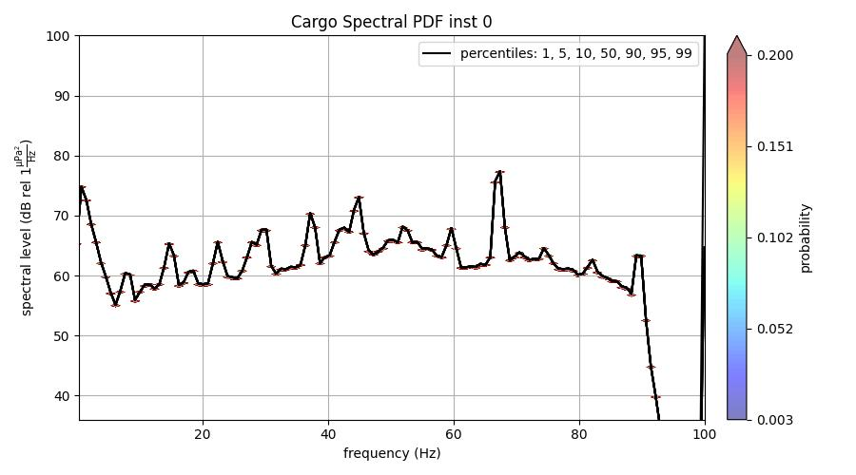
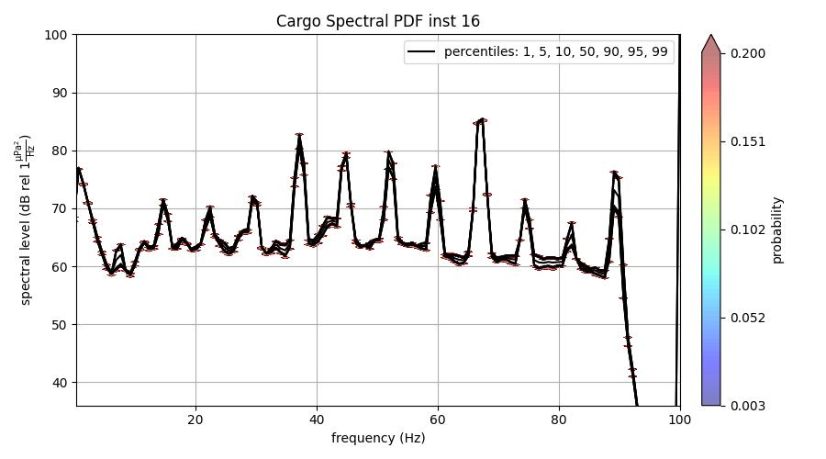

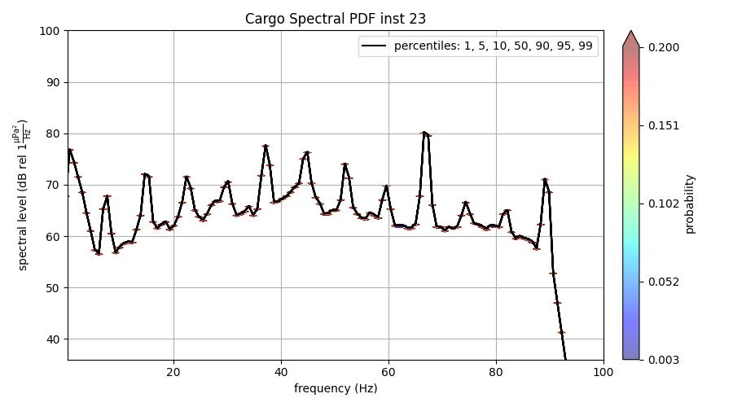
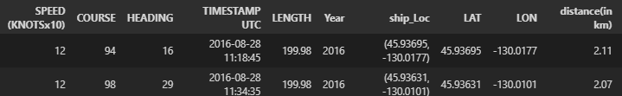
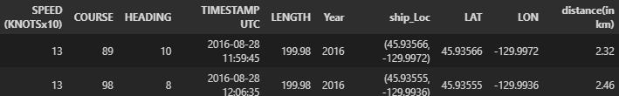
SPDF (CC)

Slide 4
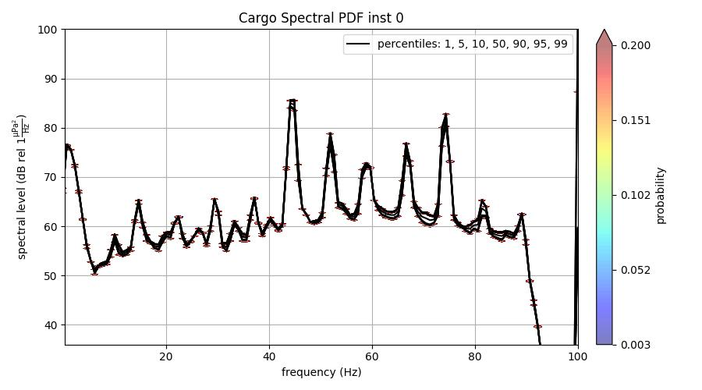
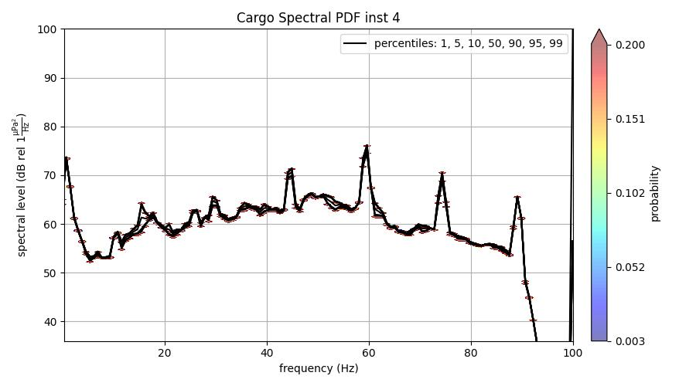
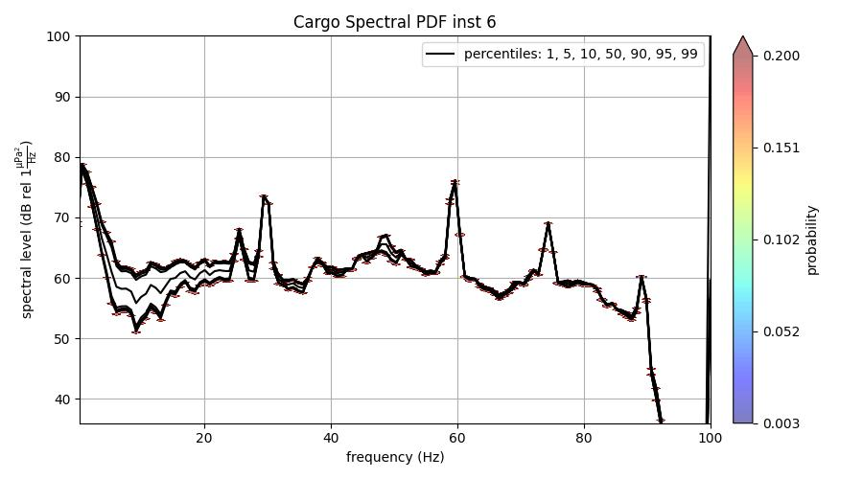
SPDF (AB)
Inst 4 & 6 shown info are the same, but use different instance_id and therefore different psd pickle files

